Slide 1

Weather Zone
This is a simple Django project which displays the weather details (current + forecast + previous) of any location in the world.

Slide 2
PURPOSE
This is a simple Django project which displays the weather details (current + forecast + previous) of any location in the world and the purpose is to make a webapp where you will get the detailed weather updates.

Slide 3
Technologies used
For front-end part:
HTML
CSS
JavaScript
Bootstrap
For back-end:
Python(3.9.7)
Django==3.1.13
For Database part:-
SQL lite

Slide 4

Code Editor(IDE)
PyCharm Community Edition(Version: 2021.3.2)

Slide 5
Features
Detailed weather detailed.
Chart View.
Easy access.
Simple UI/UX.
Searching operation for the city.

Slide 6
Requirements
Requirements for the projects run in your virtual environment for runand access the code.
Django==3.1.13
autopep8==1.6.0
requests==2.23.0

Slide 7
View of Web-App

Slide 8
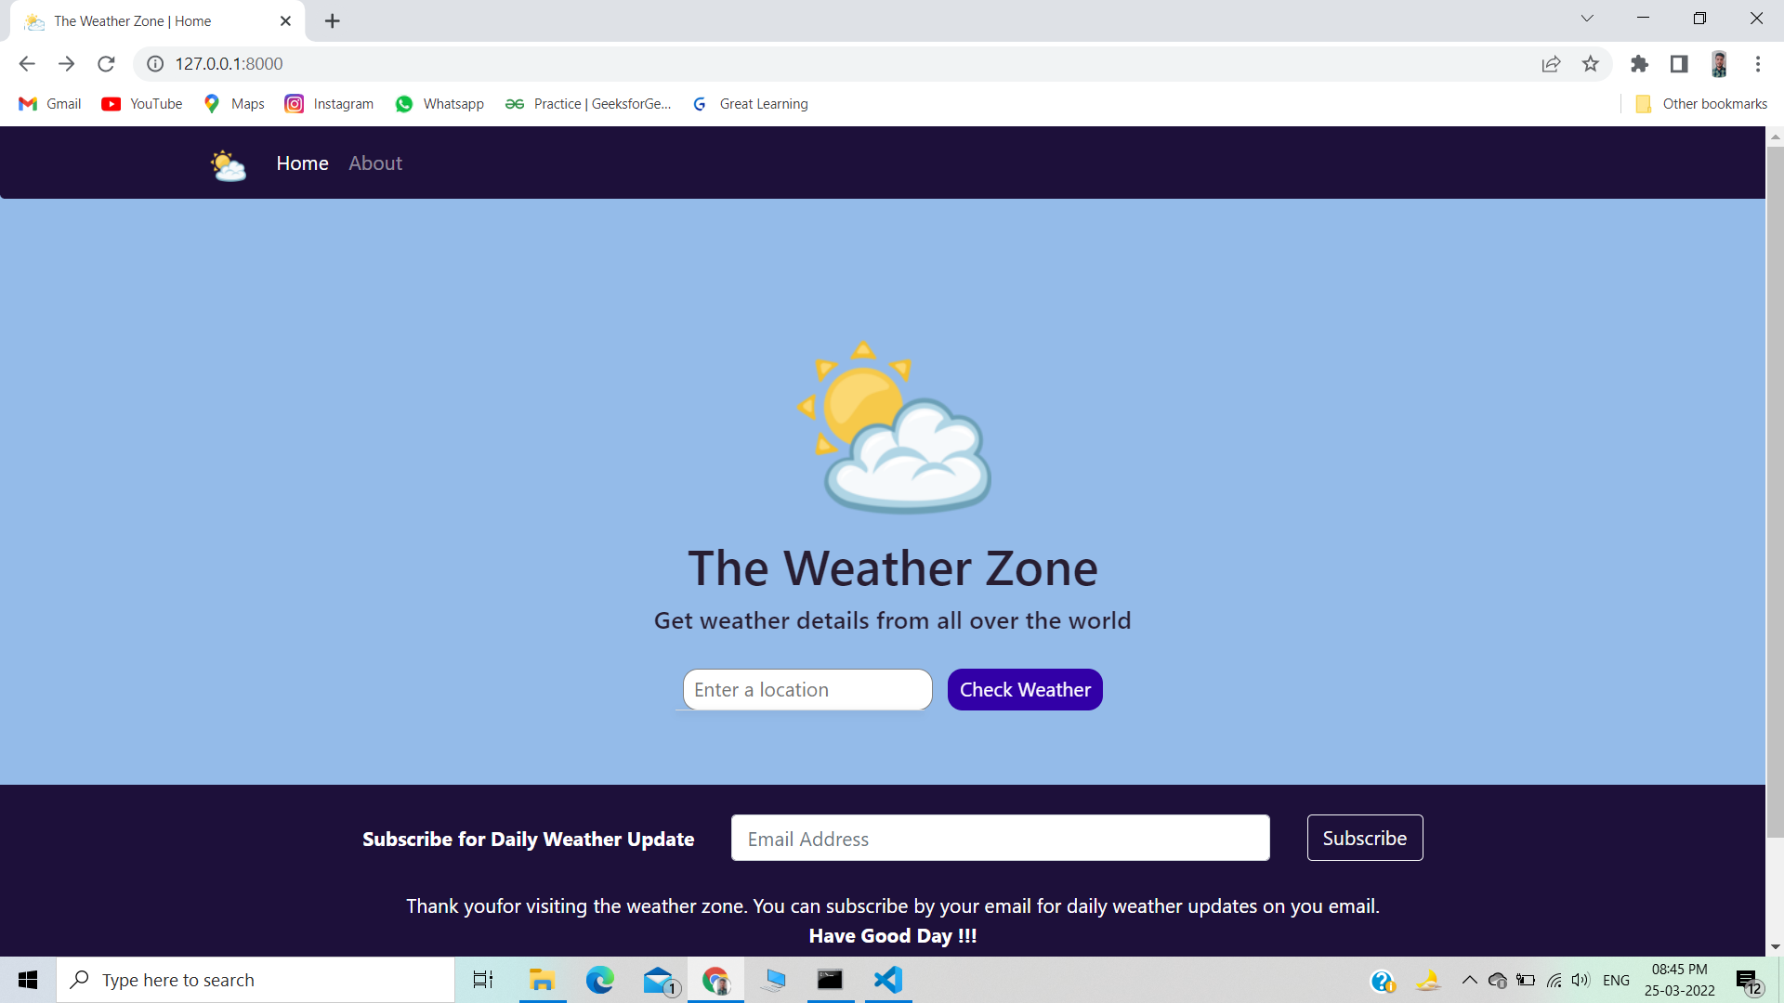
HOME

Slide 9
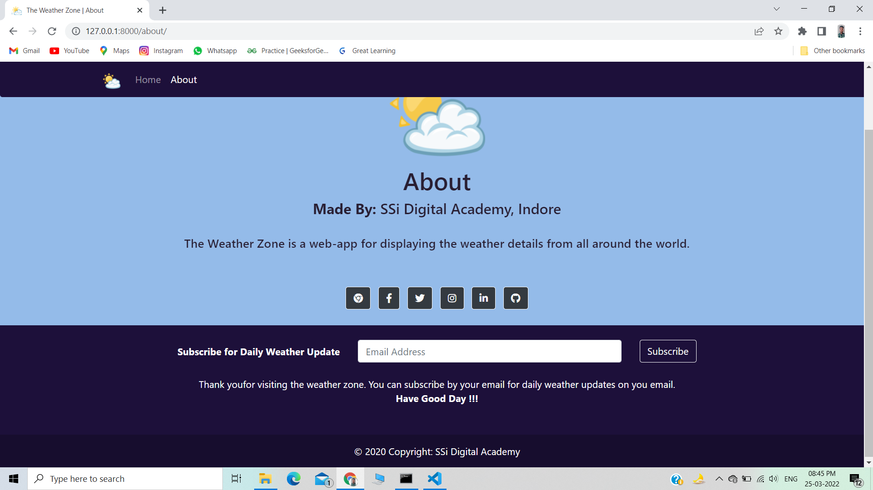
ABOUT

Slide 10
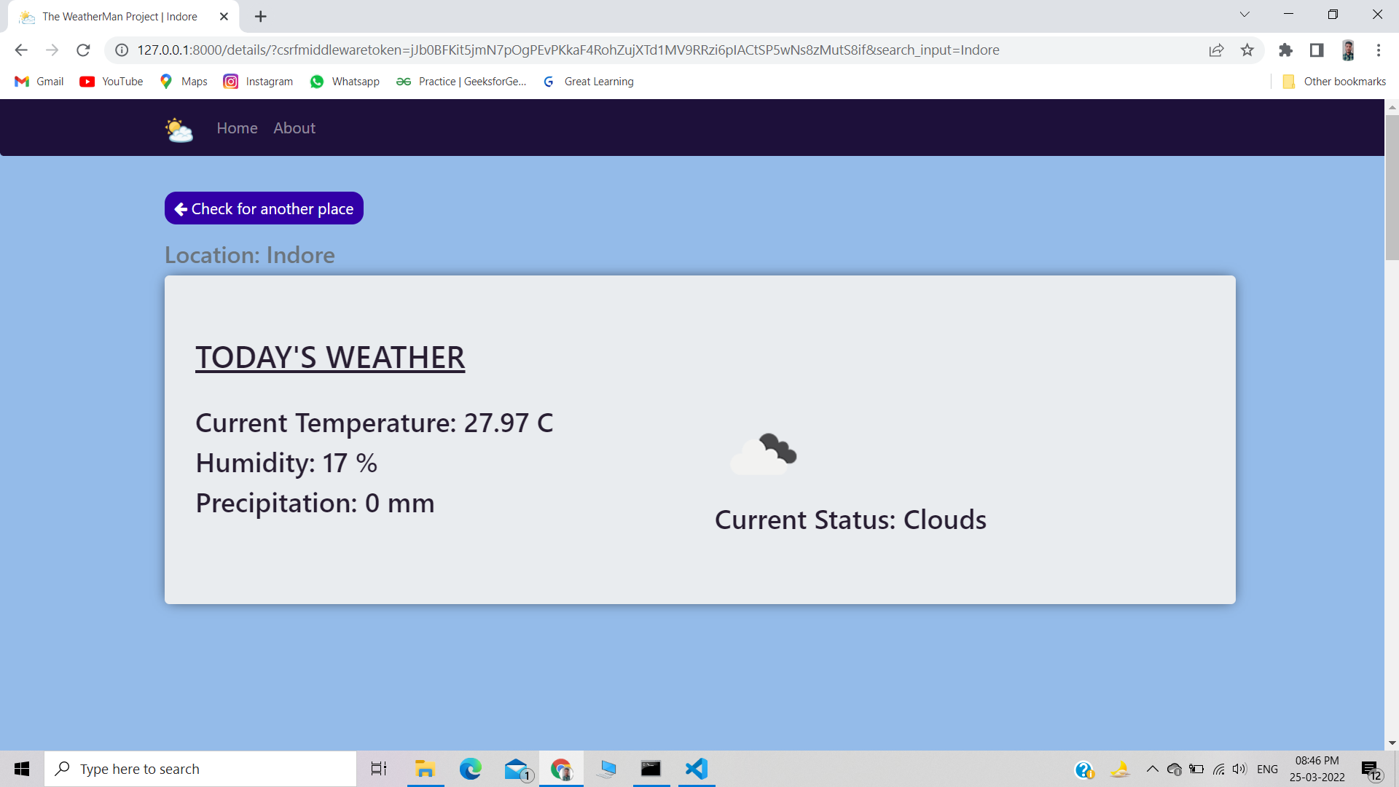
RESULT

Slide 11
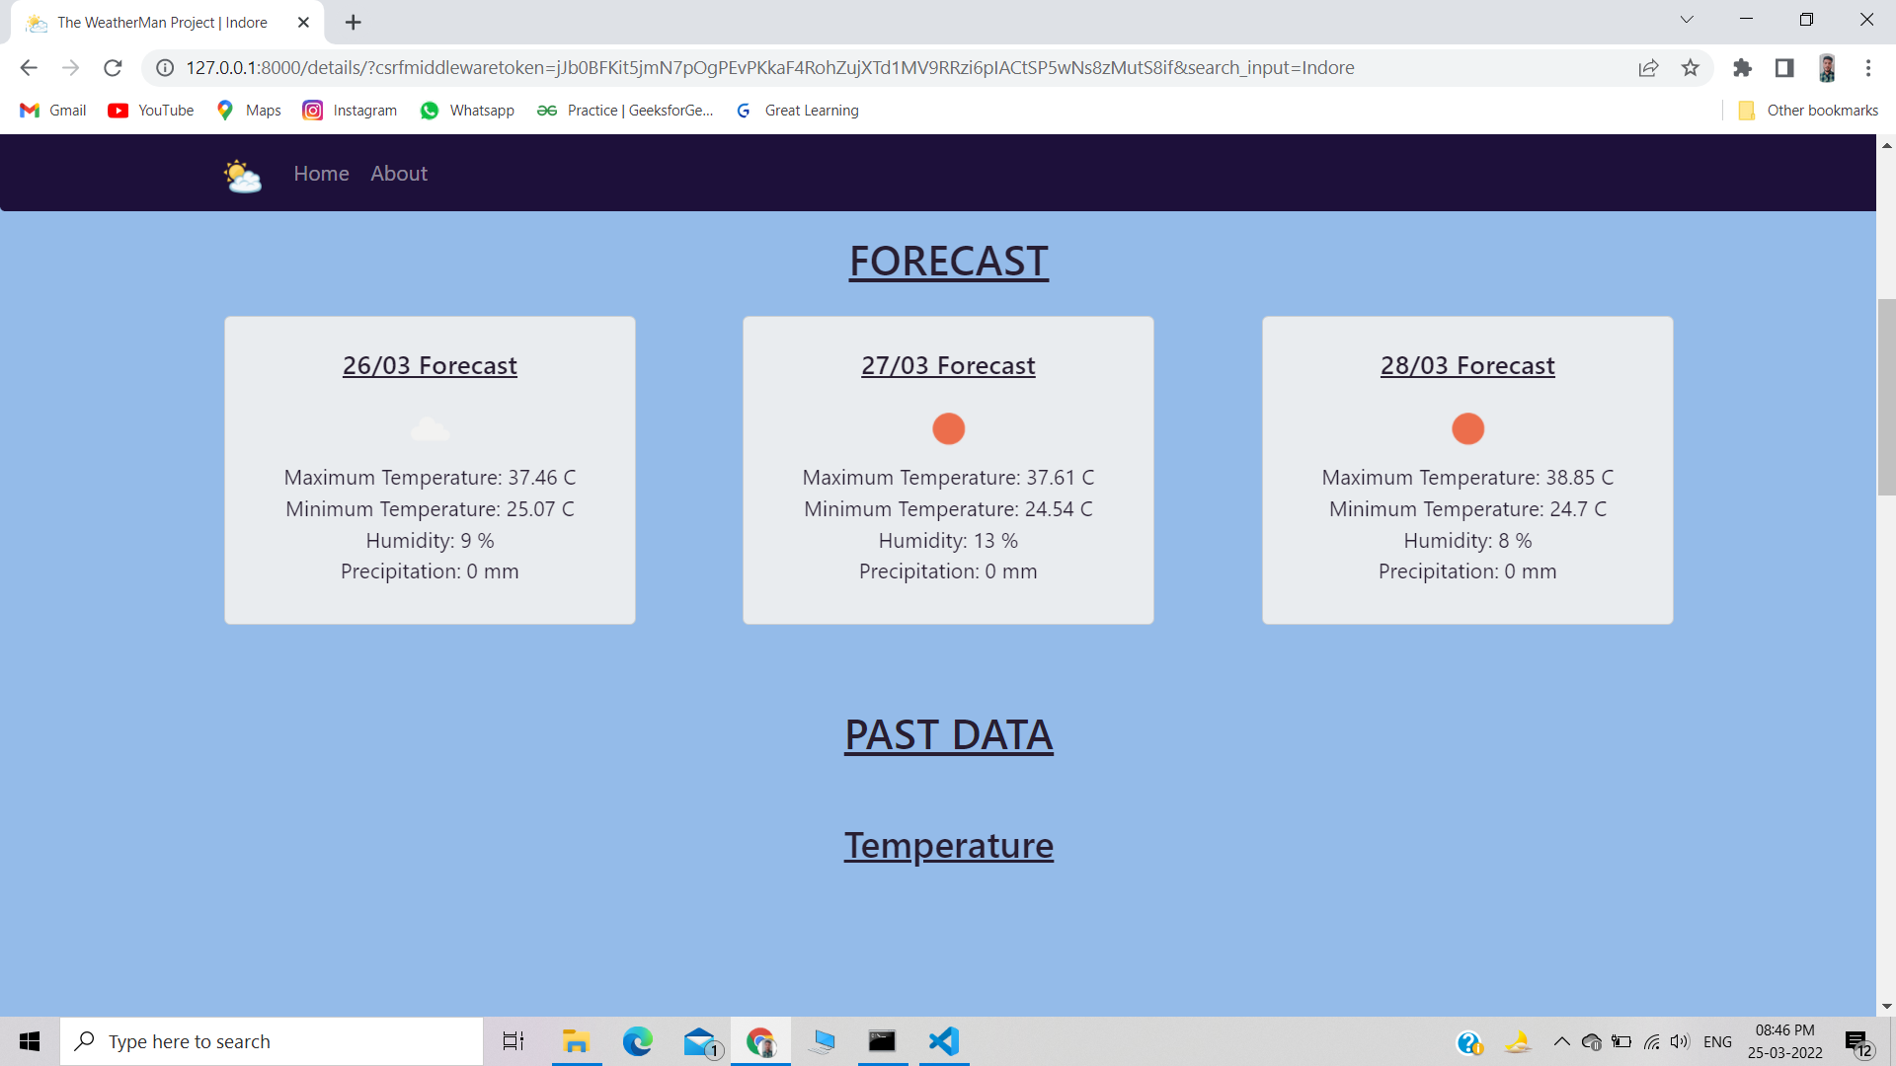
FORECAST

Slide 12
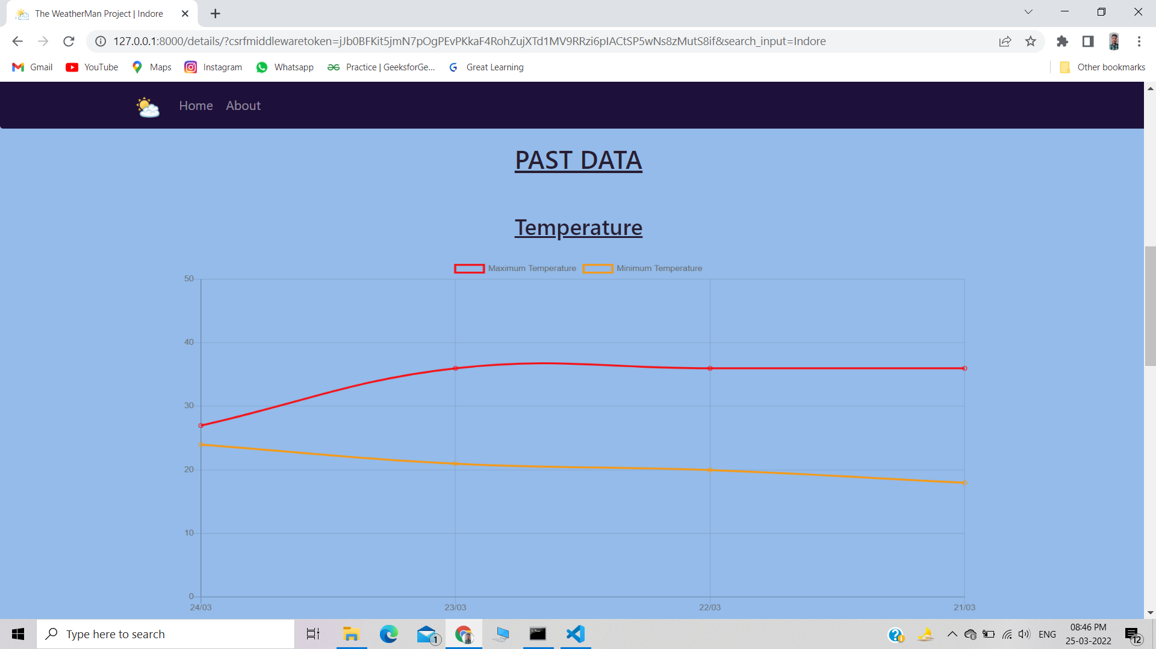
PAST DATA

Slide 13
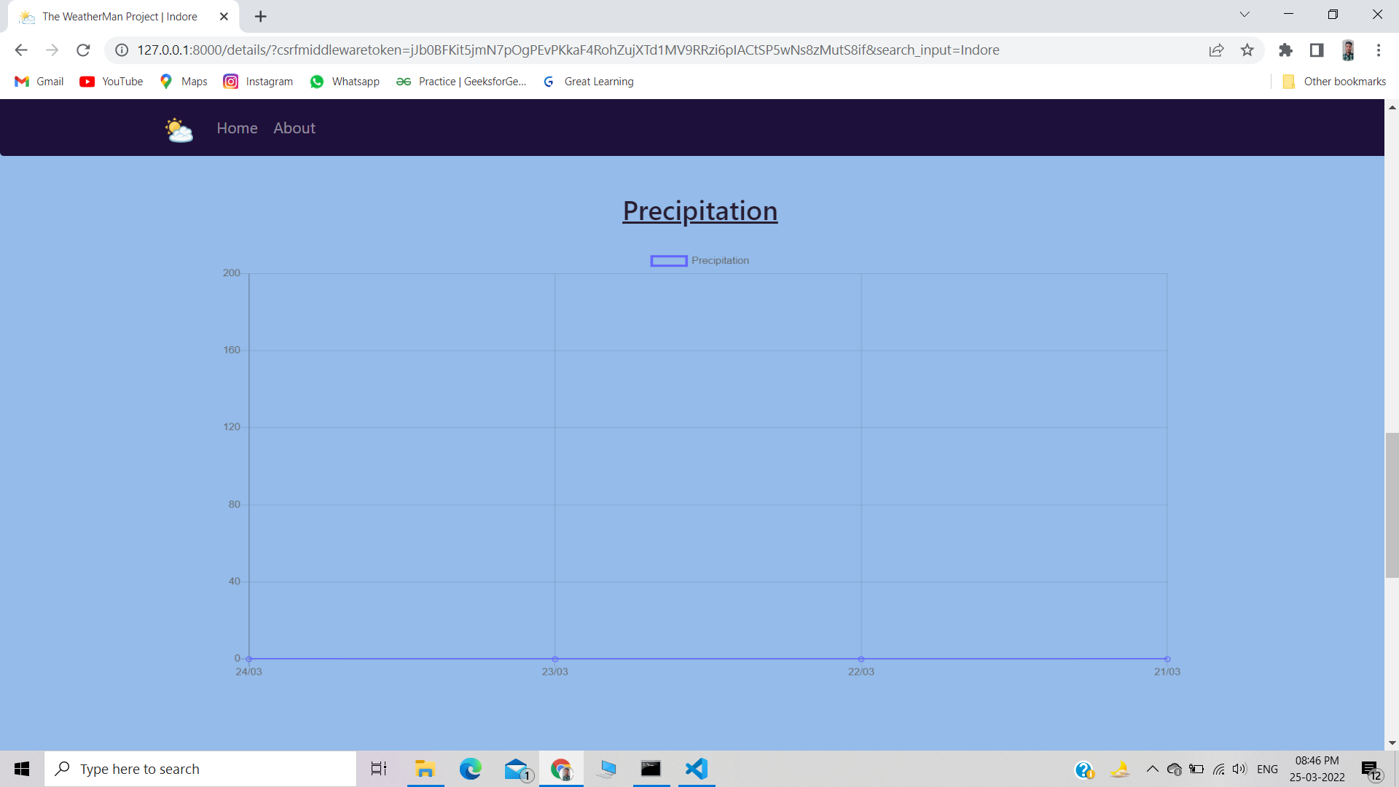
PRECIPITATION

Slide 14
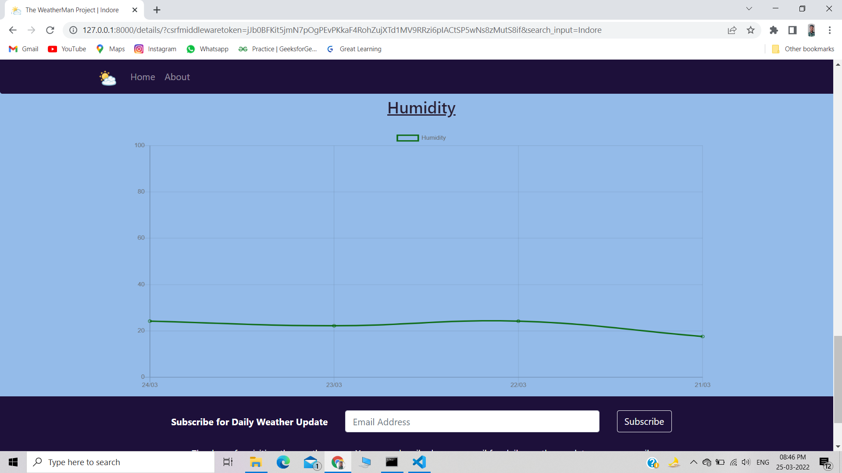
HUMIDITY

Slide 15


Thank You……
SSi Digital Academy.
https://github.com/ssiedu
https://in.linkedin.com/company/ssidigital

